Slide 1
Economy of Pakistan
Introduction
Types of economy
Challenges to the economy of Pakistan
Proposals to improve Pakistan’s Economy
Main Sectors of Pakistan’s Economy
Pakistan’s major import & export destinations
Phases of the economy of Pakistan

Slide 2
What is Economy?
An economy is the large set of inter-related production and consumption activities that aid in determining how scarce resources are allocated. The production and consumption of goods and services are used to fulfill the needs of those living and operating within the economy, which is also referred to as an economic system.
An economy encompasses all activity related to production, consumption, and trade of goods and services in an area. An economy applies to everyone from individuals to entities such as corporations and governments. The economy of a particular region or country is governed by its culture, laws, history, and geography, among other factors, and it evolves due to necessity. For this reason, no two economies are identical.

Slide 3
Types of economies
Free Market Economy
In such economies, which are mostly capitalist economies, firms and individuals decide about their own economic interests in a better way. Exchange of goods occurs in a competitive environment which brings a fair price in market for goods and services. In this type of economy individuals and businesses make their own economic decisions and they usually seen in democratic states. Such economies lead toward more economic development and growth as is evident in the case of Europe, North America and Tiger nations.
Pure market economies rarely exist since there's usually some government intervention or central planning. Even the United States could be considered a mixed economy. Regulations, public education, social security benefits are provided by the government to fill in the gaps from a market economy and help to create balance. As a result, the term market economy refers to an economy that is more market-oriented in general.

Slide 4
Command Economy
Command-based economies are dependent on a central political agent, which controls the price and distribution of goods. Supply and demand cannot play out naturally in this system because it is centrally planned, so imbalances are common.
In these types of economies all major decisions are taken by the central government. Usually these economies exist in communist or authoritarian states. The examples of such economies are Russia and China which have their own success and failure stories.
Green Economy
Such economies depend on renewable, sustainable forms of energy. These systems operate with the end goal of cutting carbon emissions, restoring biodiversity, relying on alternative energy sources and generally preserving the environment. Green economies tend to focus on technological innovations that increase energy efficiencies. The goal of green economies is to provide consumption and production while reducing or eliminating any adverse impacts on the earth and its resources.

Slide 5
Mixed Economy:
This type of economy keeps the character of the both free market & command economy. It blends the elements of both and presents a better way to cope with new emerging economic and social problems.
As discussed earlier, Majority Nation States come under the flag of mixed economies. Pakistan also is a mixed economy.

Slide 6
Key terms to remember
GNI (Gross National Income)
GDP (Gross Domestic Product/Productivity)
Economic Bubble
Import
Export
Macroeconomics
Microeconomics

Slide 7
Economy of Pakistan :
Pakistan’s Economy is a mixed type of economy.
Abundance of natural resources, human capital, excellent geographical location and hardworking masses are the strengths of Pakistan’s economy.
Low literacy rate and ignorance, shortage of capital, no regard for rule of law and institutions, inefficient and ritual–ridden social system and corrupt political environment, dominated by non-progressive elements of tribal sardars, feudal and religious advisors are some weaknesses of Pakistan economic system.

Slide 8
Challenges to the Economy of Pakistan
We Consume More and Save Less
We Import More and Export Less
Government Spends More than it Earns as Revenues
Our Share in the World Trade is Shrinking
We Badly Lag in Social Indicators
We Face Energy and Water Shortages
Cost of Doing Business is High
Crisis of Governance and Implementation Weaknesses
Uncertainty and Unpredictability due to Lack of Continuity
Political Stability, Law and Order/Security

Slide 9
Proposals to improve our economy
Change in National Psyche and Mindset
Building up of Human Capital
Use of Technology
Young Labour Force
Governance, Devolution and Decentralization

Slide 10
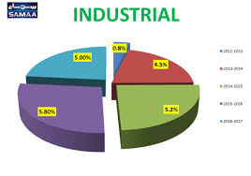
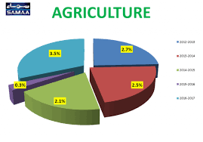
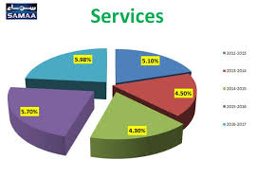
Main Sectors of Pakistan’s Economy
Agricultural Sector
Industrial Sector
Services Sector

Slide 11
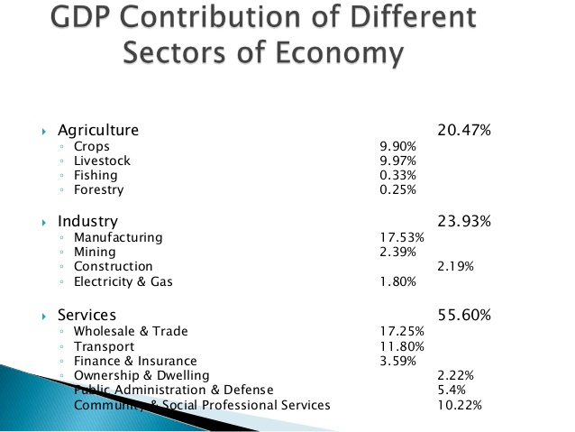

Slide 12
Agricultural Sector:
Agriculture sector is the only largest sector of our economy, contributing 21% of gross domestic product, employing 44% of total labor force, sharing 65% of exports and supporting expansion of industries by supplying raw materials.
No policy for increasing national income and raising living standard of people can be successful unless agriculture is given top priority.
Agriculture holds such a pivotal position in our economy that if in some years agricultural output falls, everybody feels the pinch.
In rural areas about two-third of population lives and their livelihood turns around allied activities and agriculture. Poverty in Pakistan is generally a country marvel; in this manner, improvement of agribusiness will be a main means for reducing neediness.

Slide 13
Total area of Pakistan is 80 million hectares. Out of this cultivable area is 23 million hectares.
Due to variety of soil and climate every type of crops and fruits are grown.
Major Crops: cotton, wheat, rice, sugarcane, maize.
Minor crops: pulses, oilseeds, jawar, bajra, gram, barley, onions, potatoes, tobacco, etc.
Fruits: apple, mango, orange, banana, guava, strawberry etc

Slide 14
Agricultural Sector : Challenges
Agriculture sector of Pakistan economy is stagnant, and its growth rate is slow. It is unable to meet the requirements of a fast expanding industry and rapidly multiplying population.
The sector has a drawback that it has a volatile nature. It is affected by the vagaries of Mother Nature, floods, pest attacks, drought etc.
The special character of agriculture causes instability of income of farmers.
The most important problem of agriculture sector is low productivity per acre and per worker

Slide 15
Industrial Sector
The most distinctive feature of a modern developed country is its strong industrial base. If a country lags in industrial growth, it cannot hope to make progress in other fields such as agriculture, transport, energy or education. It is the manufacturing sector, which can provide employment opportunities to rising population.
Manufacturing is the second largest sector of Pakistan economy, with 21% share in GDP. It employs 14% of total labor force. Rate of growth of this sector during 2014-15 was very low at 3.62%.
During the past half century, Pakistan made good progress in textiles, sugar, fertilizer, cigarettes, cement, engineering goods, plastics, electrical goods, paper, beverages, etc. However, this growth was slow so it failed to ensure higher incomes for the rising population.

Slide 16
Some Important Industries:
o Cables and electrical goods, Cement
o Chemicals and pharmaceutical, Paints
o Cosmetics
o Engineering Auto and Allied
o Fertilizer
o Food and Allied, beverages, cooking oil
o Fuel and energy
o Glass and Ceramics
o Iron and steel
o Paper and board
o Plastic and rubber
o Sports
o Sugar and Allied
o Surgical
o Textiles
o Wood and furniture

Slide 17
Industrial Sector : Challenges
Low Productivity
Poor quality products
Limited Capacity
Shortage of Capital
Energy Shortage
Lack of Advanced Knowledge

Slide 18
Services Sector
Services sector of Pakistan economy is quite a large sector as it contributes to the extent of 58% in the GDP.
It has many sub-sectors like transportation, communication and storage, retail and wholesale trade, insurance and finance, housing services (ownership & dwelling), general government services (Public administration & defense) and many other private services.
Generally, without services sector economy of any country cannot run. This sector absorbs the major labor force of the country. Other sectors of the economy are strongly related with the services sectors; it provides necessary inputs to agricultural and industrial sectors.
It also creates the linkages with other countries.
This sector is also a major source of revenue as almost 26% of revenues are collected from this sector.
By increasing investment and trade, this sector may lead to more economic growth and competition.

Slide 19
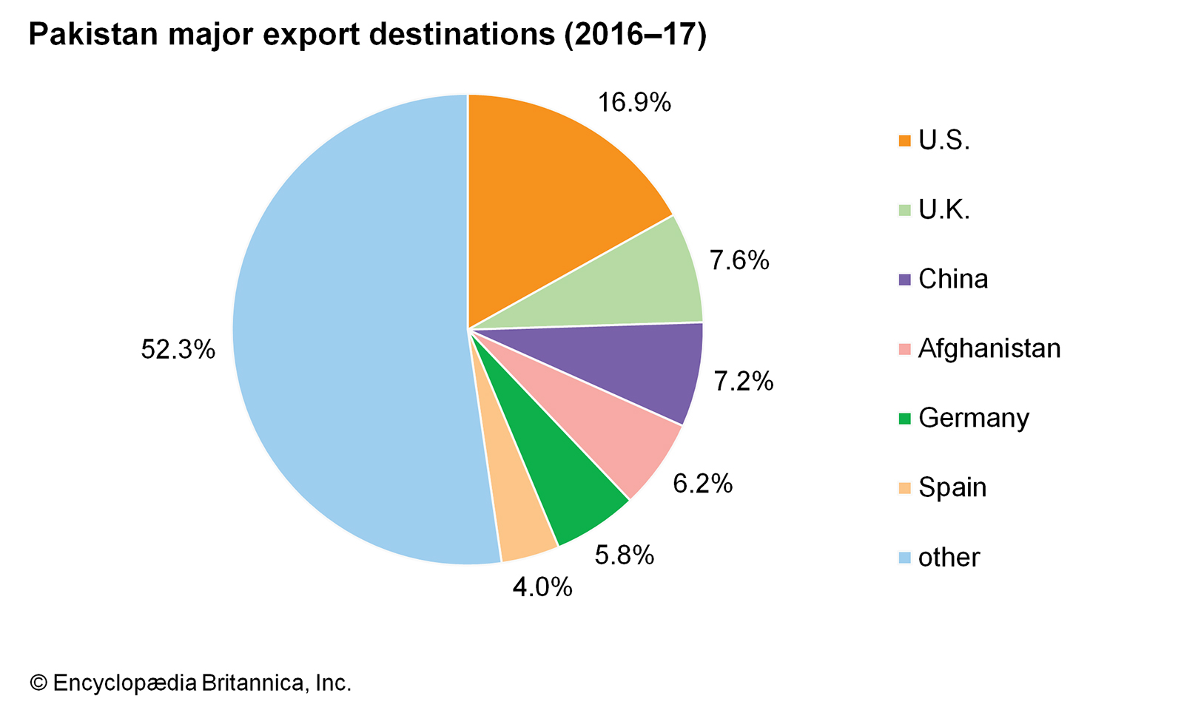

Slide 20
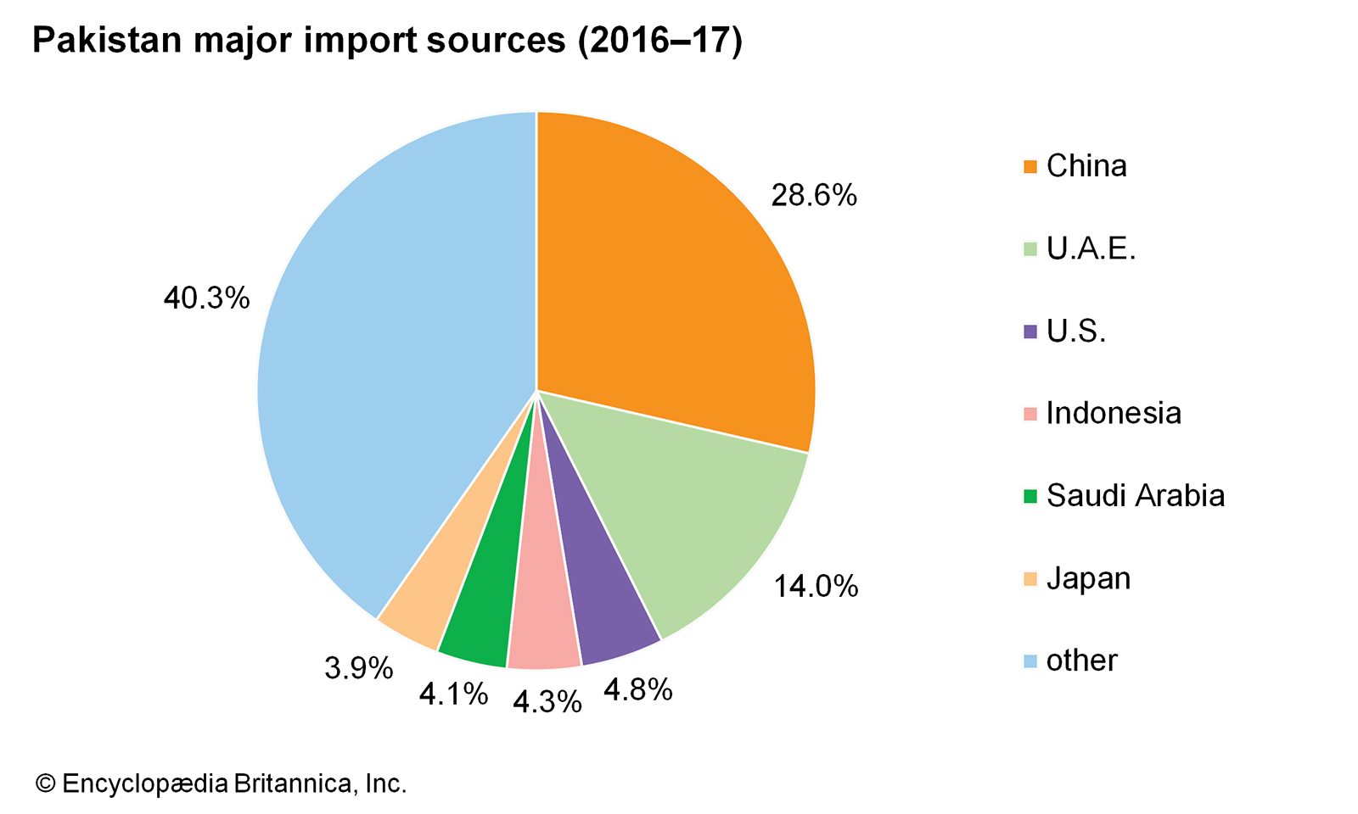

Slide 21
Historical over view/ Phases of Pakistan’s Economy
Fifties Era: 1947 to 1958
Growth Era: 1958 to 1969
Nationalization and Command Economy Era: 1971 to 1977
The Revivalist Eighties: 1978 to 1988
The Muddling Nineties: 1988 to 1999
The Reforming Era: 1999 to 2007
Privatization Era: 2008 to 2013
Notes:
Refer to the supporting lecture for details

Slide 22
Conclusion
At the time of independence Pakistan’s economy, which had nothing to survive, has made his way in the line of developing country through many experiments in political and economic history.
The economy had witnessed relatively free market system at one time (mostly in democratic government periods like 1988 to 1999 and 2008 till now )
Command system was experienced at the time of 1971 to 1977 and all dictatorship eras.
For this reason, the economic history of Pakistan becomes more interesting. Despite having such turbulent time, Pakistan has witnessed the time of fastest growth in South Asia region.
However, the inconsistent policies and narratives of every government failed this state many times. These variable policies are still freezing Pakistan to live among the developing world.
The capitalists and landlords, who emerged because of different economic follies, have hijacked the economic development of the country.
Beside this, the linkage with international monetary institutions during 80’s also started to engulf the economic independence of the country and has trapped this country into a vicious debt trap.

Slide 23
Pakistan is rich in all types of resources, but the situation is getting worse with every passing day. Despite of having vast reserves of coal, oil, gold, gas and many other valuable minerals, Pakistan is depending on international aid for its economic and social revival.
Pakistan has vast fertile land which led it to self-sufficiency in food. The share of different sectors in the economy has been changed much since independence.
Pakistan has also a large pool of human resource which can be turned into productive one by adopting a wise policy.
Now the agriculture is sharing almost 21% in GDP which was more than 50% at the time of creation of this state in 1947. Whereas, the industrial and services sectors have gained in their share in GDP up to 20.9% and 57.7% respectively from 8.03% and 39.3% in 1947.
The trade account remained in deficit during most of the years in history and is still in the same condition due to more dependence on imports.
The excessive dependence on imports and shortage in energy sector has also disturbed our foreign exchange reserves.
The continuous devaluation of Pakistani rupee is also a result of these economic problems.
Public debt, to manage the economy, is rising sharply as it reached more than 60% of GDP.
It is evident from the above discussion that Pakistan’s economy has a lot of problems, so an integrated economic, social and political framework is needed to bring Pakistan out of this imbroglio.

